Slide 1
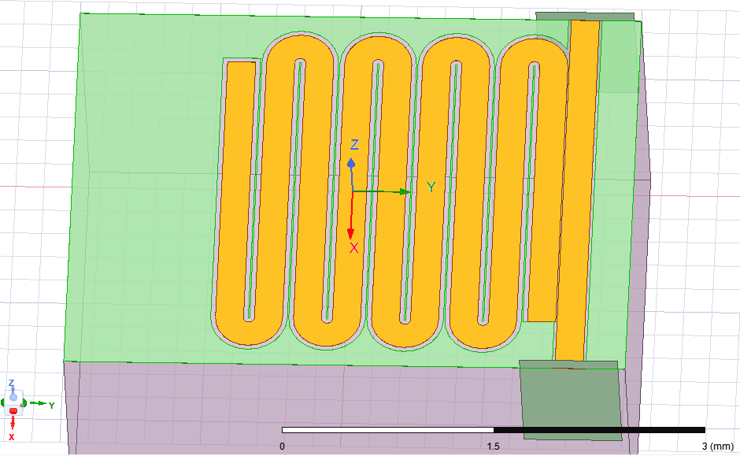
Port 1
gnd
Load end
Feedline
λ/4 line
Gnd end
substrate
Port 2

Slide 2
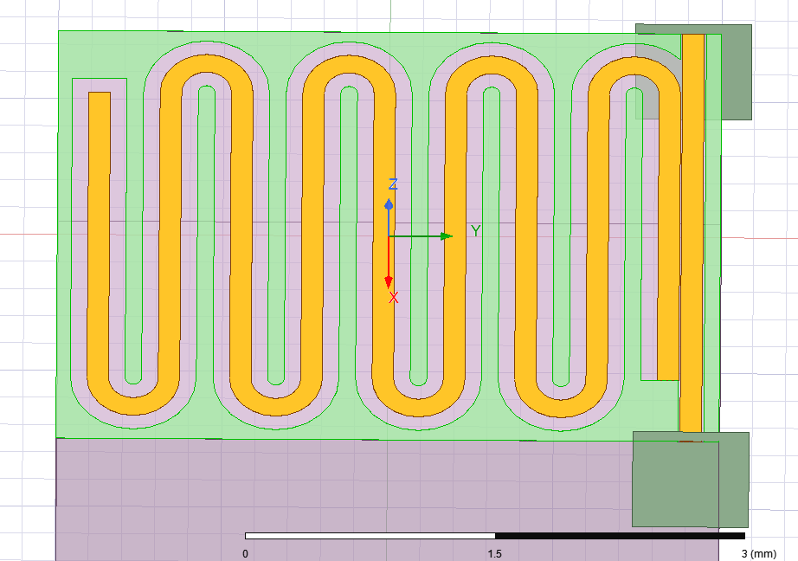
Port 1
gnd
Load end
Feedline
λ/4 line
Gnd end
substrate
Port 2

Slide 3
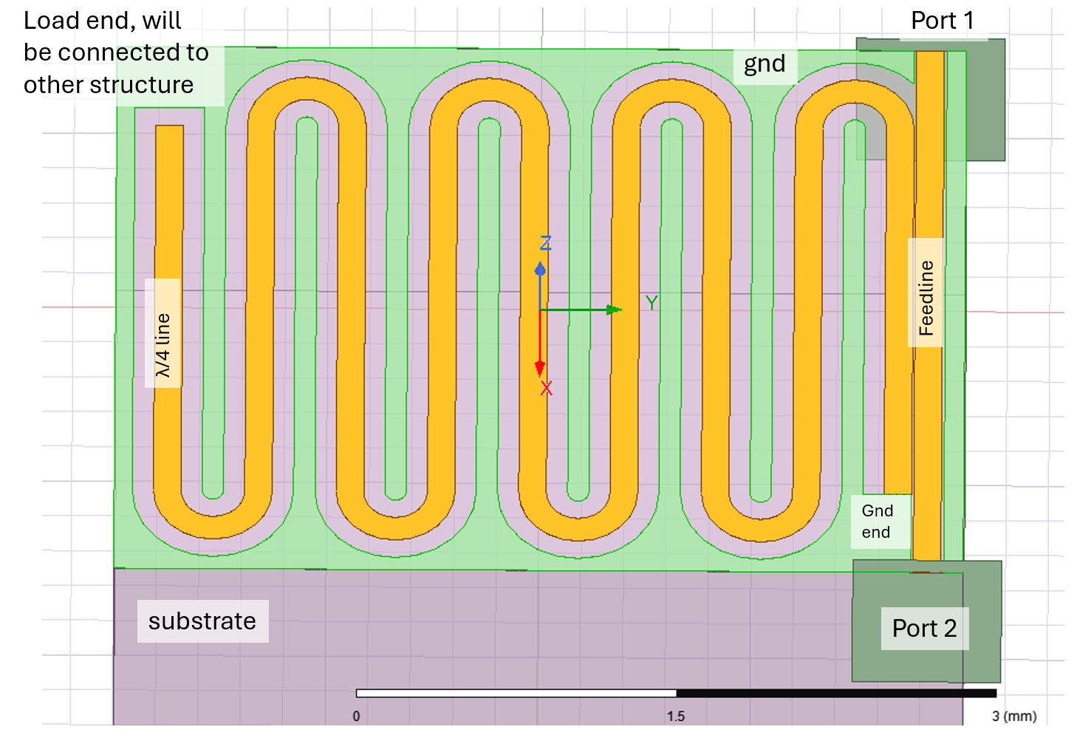
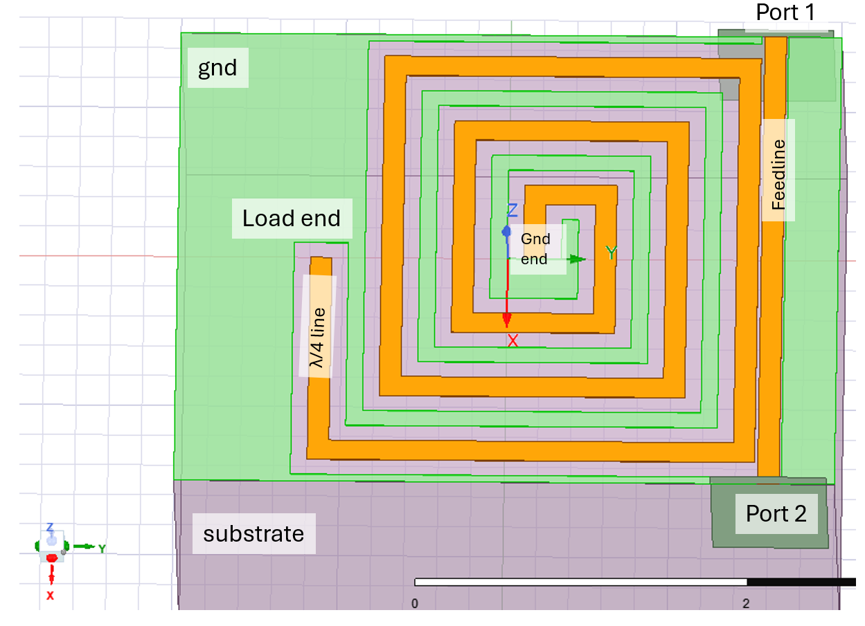

Slide 4
Port 1
gnd
Load end
L_res_vert
D_gap
Feedline
D_gnd
D_couple
D_gnd0
D_feedline_gnd
λ/4 line
W_res_vert
Gnd end
substrate
Port 2

Slide 5
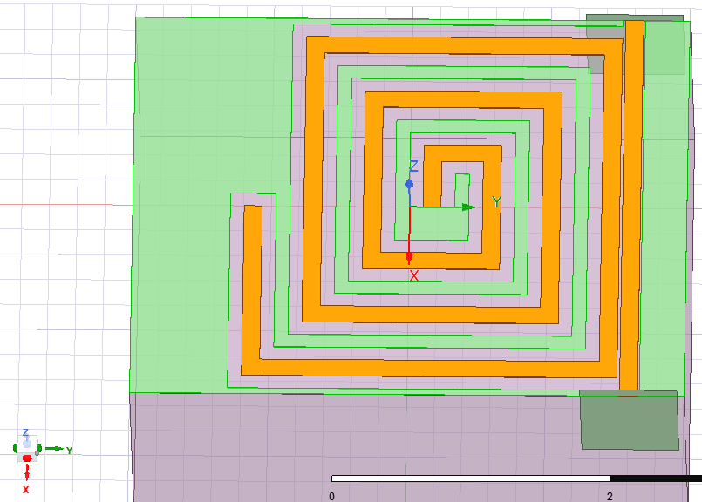
Port 1
gnd
Feedline
Load end
Gnd end
λ/4 line
Port 2
substrate

Slide 6
Port 1
gnd
Feedline
Load end
D_gap
Gnd end
D_couple
D_spiral_end_gnd
D_gnd
D_feedline_gnd
λ/4 line
Port 2
substrate

